Slide 1
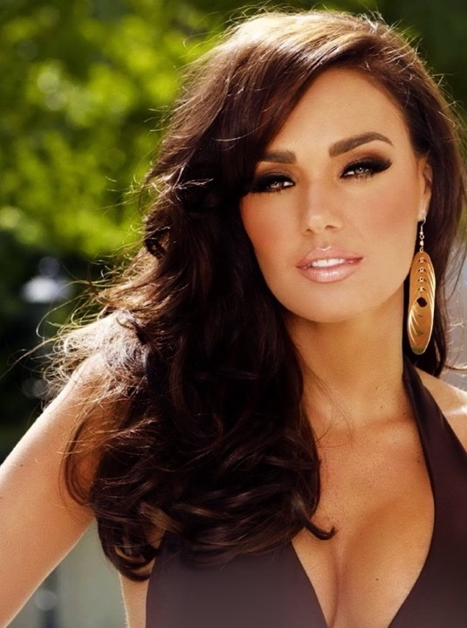
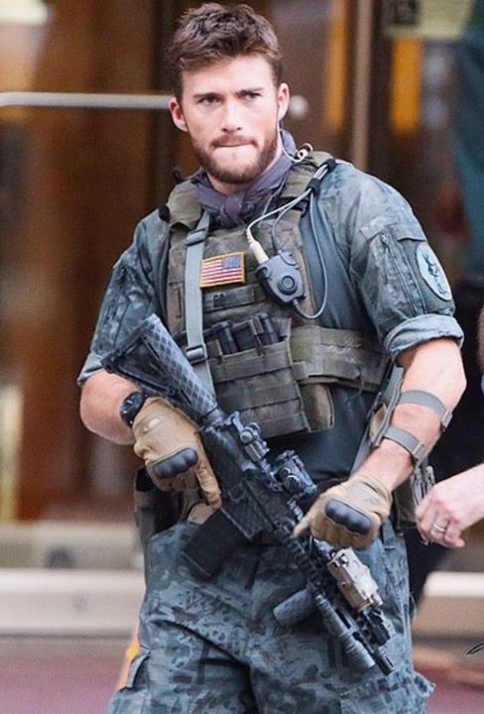
The Godfather Legacy
SERIES BIBLE
A Television Series Screenplay
by Garymerle Koeppel
When a notorious Mafia Godfather is pardoned from prison and murdered by his gangster daughter, an unknown son inherits $33 billion that he plans to spend it on good works, but the sister he never knew learns about the money, she plots to kill him and take the money to expand her criminal empire, which triggers a life and death struggle for the Godfather Legacy.
(Photos are characters as envisioned by Screenwriter.)

Slide 2

ANTONIA COSTELLANO is the daughter of a Mafia
Godfather and an Arab mother who he bought from a trafficker and used as a sex slave.
When her mother gave birth to a girl instead of a boy, Antonio cast her into the street where she whored for food and died with a broken heart.
While Antonio was in prison, Antonia converted
his criminal operations into corporations that look legitimate but are criminal enterprises.
To avenge her mother’s cruel death, she bribes
the governor for Antonio’s medical pardon and
sadistically kills him when he is released.
Before dying Antonio revealed he had entrusted a cache of money to his consigliere, Tom Baxter, who Antonia vows to find and get the money.
But she doesn’t know that Tom gave the money to an unknown step-brother or that the money is now worth $33 Billion.
Antonia Costellano

Slide 3
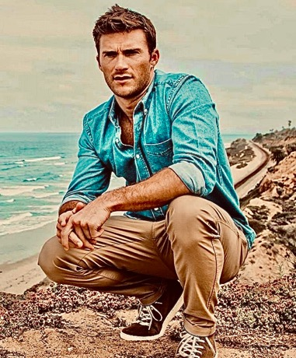
SCOTT ADAMS is the unknown son of a Mafia Godfather whose mother gave him to her sister to raise because she feared for him living his life in a a crime family.
Scott grew up in a wealthy home and excels in scouting, sports and scholarship, but
is unspoiled by his privilege life.
He served in the Desert Wars as an Army Ranger Captain where he was wounded but saved by a heroic canine soldier, Shadow.
While recovering from his wounds in Maui, he fell in love with a Hawaiian princess and brought her home to his Big Sur cabin.
A stranger delivers a laptop containing a $33 Billion inheritance that he initially rejects but
decides to keep and use for good works.
Little does he know that he has a criminal
Step-sister who is searching for the money and, when found, will kill him.
Scott Adams

Slide 4

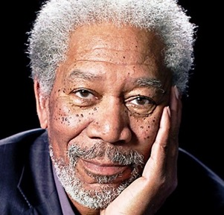
SALVATORE VINOSA, Antonia’s trusted lieutenant and only friend, was her father Antonio’s Capo. When Antonio
went to prison, Antonia took over the family’s vast criminal enterprises and Sal became her protector and enforcer.
Sal provides balance to Antonia for her insatiable quest for power
and for the sadistic methods she uses to kill and dispose of her
enemies. He calms her when she spins out of control.
Sal helped Antonia transform the family crime operations into corporations that appear legitimate but are criminal. Despite his advice, she refuses to quit the trafficking operation, which he considers perverse because her mother had been trafficked, bought and enslaved by Antonia’s father, Antonio Costellano.
LEILANI KALI’I, is Scott Adam’s Hawaiian fiancé who saved him from drowning after her surfboard struck him. They fell madly in love. Because she descended from the last Hawaiian monarch, her family wants her to marry a pure Hawaiian to retain the bloodline, but her love for Scott takes her to his cabin in Big Sur.
Leilani is an island Princess who loves her land and her people.
She finds it difficult to live in a different culture and a remote area
without her friends and family. She paints nature and when alone
she secretly dances the Sacred Hula to retain her cultural roots.
When Scott inherits a vast fortune, he devotes himself to using
the money for good works. When he becomes obsessed with saving trafficked girls, her love wanes and she becomes attracted to a Big Sur sculptor who woos her with his passion.

Slide 5
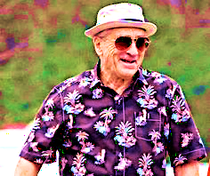

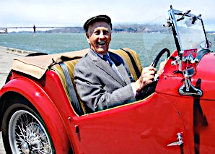

TOM BROWN was Antonio Costellano’s Consigliere. When Antonio was sent to prison for racketeering, he entrusted Tom with $30 million he had stolen from the family. Tom loved Antonio’s wife, Katherine and helped her to escape from Antonio and give birth to his unknown son. When Antonio is killed, Tom bestows what has become a $33 billion trust fund to Antonio’s blood son and legitimate heir, Scott Adams.
KATHERINE BROWN is Antonio Costellano’s wife and Scott Adam’s birth mother. She lied to Antonio when telling him she had aborted their son and instead, she gave him to her sister Susan to raise. She and Tim live a quiet and happy life on Maui.
ARNOLD ADAMS, Scott’s Stepfather, is a wealthy retired surgeon who never accepted Scott as his stepson and Scott never accepted him as a stepfather. Scott rebelled at 16 and moved to the old family cabin in Big Sur to live and finish high school.
SUSAN ADAMS, is Katherine’s sister and Scott’s step- mother. She loves Scott as her own son and sends photos of Scott’s life to Katherine so she can vicariously share in her son’s life.

Slide 6
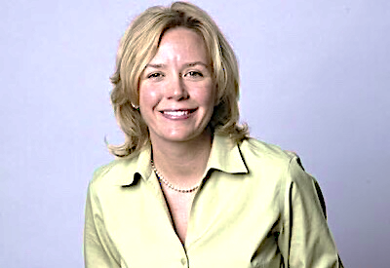
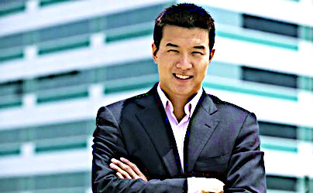
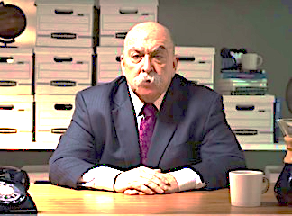
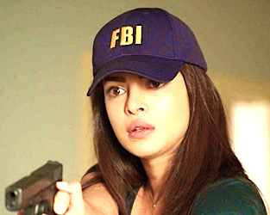
JEANNETTE WATTEN is Scott’s Attorney and High School sweetheart who still loves him
but respects his new fiancé and remains aloof.
CHEN PAO is Scott’s Financial Advisor, but
questions the source of Scott’s money and
suspects it came from criminal activities.
SMITTY O’BRIEN was the undercover FBI
Agent who arrested Antonio Costellano
and ironically now searches for his killer.
CARMEN LOPEZ is a rookie FBI white-collar crime
specialist who is searching for the money Antonio concealed from the FBI during his arrest and trial.

Slide 7
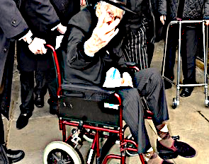
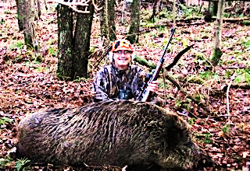
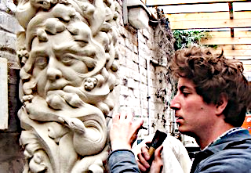
UNCLE AL REEVIS is a Big Sur Boar hunter who befriended Scott when he rebelled against his stepfather and moved into the
old Adams family cabin in Laffing Canyon.
Al is the father Scott never had. He taught him how to revere the land, hunt like an Indian, and kill only upon the need to kill.
TIM HUNTER, a Big Sur Sculptor, fell in love with Scott’s fiancé, Leilani. His flirting angers Scott, but Tim cannot restrain his feelings.
Tim becomes more daring as Leilani escapes into her paintings because Scott as becomes obsessed with helping homeless people and rescuing victims of human trafficking.
ANTONIO COSTELLANO is a notorious and ruthless Mafia Godfather who was convicted of RICO and sentenced to life in prison.
He always suspected Antonia, his daughter whose mother he bought from a trafficker, and who blamed him for her death in a brothel, to be the one who ratted him out.
Before his incarceration, Antonio entrusted his Consigliere with $30 million he had secretly stolen from his family.
Although Antonia had taken over all his family businesses, Antonio was pleased she bribed the governor for a pardon. Little did he suspect what she had in mind for him.

Slide 8
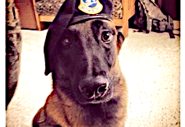
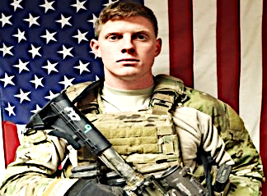
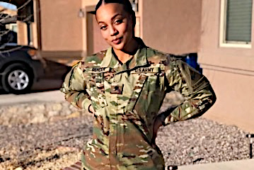
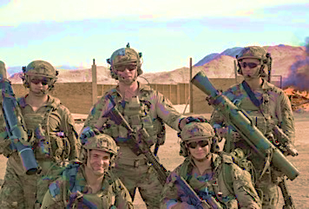
SHADOW is a decorated Ranger K-9 who saved Scott in Afghanistan and he is now
Scott and Leilani’s best friend and guardian.
HANK HAMMER was Scott’s XO in the Desert War . When Scott inherits his trust fund, Ham joins his civilian vigilante team and becomes his operations officer and personal security chief.
Hammer is in love with fellow Ranger, Lara, but he is too shy to approach her with his feelings for fear she will reject him.
LARA “HOT LIPS”, was part of Scott’s Ranger
Team. She was a translator who interrogated
prisoners and a computer technician in change of all communications in the command center.
She has strong feelings for Hammer but hides them with her teasing humor. She fears getting involved with a white man despite her feelings.
Four of Scott’s former Ranger Team serve as volunteer vigilantes in his crusade to capture and destroy a ruthless human trafficking ring.

Slide 9

A C E
Antonia Costellano Enterprises
ACE-MODS is an Executive Escort Service featuring beautiful male and female models who are professional sex providers and skilled corporate spies. They are specifically trained to gather information used to control, manipulate and blackmail individual and corporate clients.
ACE-BETS owns the Five Aces Hotel and Casino in Reno, which is famous for including a fifth ace in every deck, allegedly improving a gambler’s odds, but in truth it diminishes their odds. The online gambling website is domiciled offshore. For all bet payouts, Antonia exclusively pays with ACE-COIN, her own cryptocurrency.
ACE-PILLS are sex drugs milled in an offshore factory. FDA officials are bribed or blackmailed to obtain official FDA approvals, which allows dangerous drugs to be sold legally, over-the-counter. This eliminates the cost of street distribution and gang wars.
ACE-COIN is a cryptocurrency Antonia designed to use instead of dollars for capital purchases, business expenses, pay offs, gifting and charitable donations. The coin value is controlled by an ACE-DATA algorithm that manipulates the price when buying or selling assets.
Antonia’s Penthouse Apartment on Roof of Ace Casino
ACE-CLOUD is a supercomputer, data management center that stores the digital information, conversations and videos of all clients in the ACES network. Data is gathered from all operations and employed when needed for intimidation, manipulation, bribery, corporate sabotage, insider trading, and more.

Slide 10
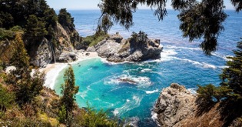
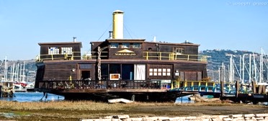

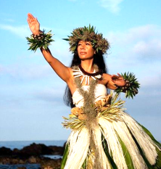
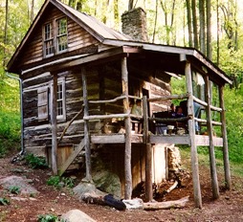

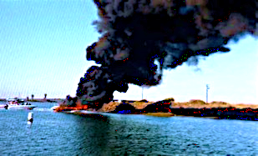

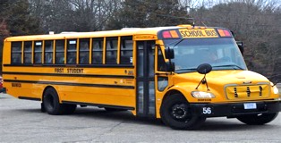
The Godson Bible
Season One
Episodes 1-9

Slide 11

THE GODSON™
Episode 1
Legacy in a Laptop
Mafia Godfather Antonio Costellano is released from prison and killed by his daughter to avenge the death of her mother. Before he dies, she learns he entrusted $30 million to his Consigliere Tom to invest, and she vows to find it. The FBI searches for Antonio’s killer and his missing money.
Scott Adams, Antonio’s unknown and only son, inherits a laptop containing what has grown into a $33 billion trust fund. He learns the money came from a father he never knew and the mother he thought was dead is alive.
Antonia has converted Antonio’s street crime businesses into thriving criminal enterprises that include escort services, espionage, extortion, gaming, drug manufacturing and cryptocurrency, which are legitimate in appearance only.
Episode One ends with Antonia searching for the money Scott is using for good works. The FBI is investigating Antonio’s murder and the missing money. Scott is chasing a trafficker who, unknown to him, is his criminal step-sister, Antonia.
The Laptop containing Scott’s Inheritance

Slide 12

The Godson™
Episode 2
Retreat to the Future
Scott and his fiancé, Leilani, go to his Cabin in Big Sur
to process the large inheritance from Scott’s Mafia Godfather and the discovery that Scott’s mother had abandoned him as a baby and was alive, not dead.
Antonia has legitimized every historic family business except human trafficking, despite the advice from Sal to abandon it. She is livid about losing girls to a team of vigilantes lead by her unknown half-brother, Scott.
Scott decides to build a revolutionary rehabilitation
center for the homeless. Antonia pressures her high-
tech sleuth to find Antonio’s Consigliere Tom so she can recover the trust fund she believes is hers.
Uncle Al, the Big Sur boar hunter, discovers a gang of
traffickers are offloading girls from a fishing boat to
a secluded beach. He contacts Scott to investigate.
Big Sur Mule Cabin

Slide 13

The Godson™
Episode 3
Building The Bridge
Scott plans The Bridge, a rehabilitation facility for the
Homeless. He meets with architects and contractors,
physicians and psychiatrists, counselors and ministers.
Scott buys the Vallejo Houseboat in Sausalito and
renovates it for their home and operations center.
Leilani’s brother Kimo owes the Honolulu mob a large
gambling debt. Another brother, Keola, is in jail for
his Hawaiian Sovereignty Movement demonstrations.
Her third brother, Kane, please with her to return home.
Uncle Al shows Scott the cove that traffickers are using
to offload trafficked girls. The Rangers surveil the Big
Sur Coast and plan a raid to rescue the girls.
The Bridge - Prototype Homeless Rehabilitation Center

Slide 14
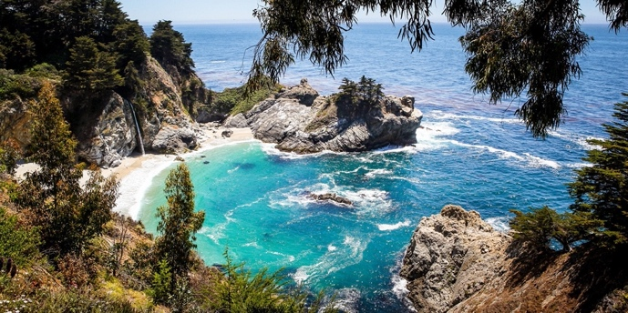
The Godson™
Episode 4
Big Sur Bust
The Ranger Team intercepts the traffickers at Smuggler’s Cove in Big Sur and follows them in order to capture their ringleader.
Antonia orders Sal to kill the Priest in the Chinatown church where the Rangers delivered the rescued girls. Sal tries to persuade her to abandon her human trafficking business.
FBI Agents Smitty and Carmen interview Antonia at her Ace Casino office about Antonio’s murder.
The Rangers track the trafficker’s van from Big Sur to their Pebble Beach stash house. After a brief fire fight that kills the traffickers, the Rangers rescue twelve girls.
Trafficker’s Snuggling Cove

Slide 15

The Godson™
Episode 5
Weaving the Web
Scott’s Rangers change their tactics and
take the initiative to capture the traffickers.
The Geek narrows his search for Tom so
Antonia can find him and and the money.
Scott sets a trap on the Dark Web by listing
twenty young girls for sale, hoping to snare
the ringleader when they meet to exchange the girls for the money.
The FBI confirms a large sum of money
from Antonio’s Casino was never found.
Antonia orders the Geek to buy the girls
Scott advertised on the Dark Web to replace the ones he recently stole from her.
Half-way Shelter for Rescued Trafficked Girls

Slide 16
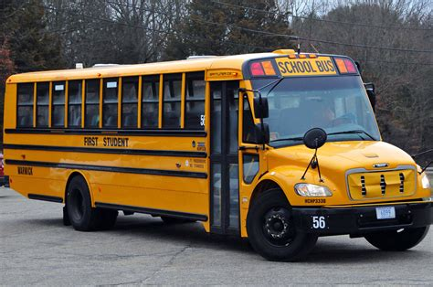
The Godson™
Episode 6
Spider in the Web
The meeting is confirmed. Lara assures the Geek the girls
are genuine and sends him random photos from the web.
Sal gives Antonia an ultimatum to retire from trafficking
and to expand ACE MODS, her legal escort service.
Leilani’s brother Kane again pleads for her to come home and
help Kimo and Keola with their problems.
The Rangers park a school bus on a dock in Alameda
filled with twenty mannequins dressed as young girls.
Antonia and Sal swoop down in her ACE ONE helicopter
to kill the dark web sellers. The Rangers grab her money,
but she discovers their trap and escapes unharmed.
Antonia and Scott get photographs of each other during
the raid and will soon discover their respective identities.
School with Mannequins of Trafficked Girls For Sale

Slide 17
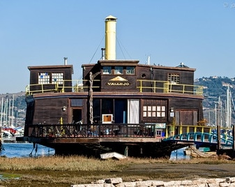
The Godson™
Episode 7
The Pacific Gateway
Antonia takes revenge on her trafficking boss, Noodles,
for making another mistake costing her money and girls.
Scott obsesses with his projects. Leilani is unhappy and
moves to the Big Sur Cabin. Scott fears losing her to Tim
and agrees to attend the Kali’I family Luau in Maui.
The FBI finds a file photo of Antonio and Tom together in
the casino. The Geek locates Tom and Katherine’s names
on a Birth Certificate from the Carmel Hospital.
From photos taken of Scott at the school bus sting, the
Geek ID’s and traces him to a houseboat in Sausalito.
Antonia tells Sal to wire cameras in the Vallejo parking
Lot and rig C-4 explosives on hull of the houseboat.
The Vallejo Houseboat in Sausalito

Slide 18

The Godson™
Episode 8
The Family Luau
On Maui Scott and Leilani swim and surf in the same
cove where they met and make love on the beach.
Tom brings Scott to their Plantation House where he
meets his mother Katherine for the first time.
Scott surprises Leilani with a marriage proposal
and they marry in an old stone church in Makenna.
Leilani’s brother Kane hosts the Luau, Keola talks
sovereignty politics and Kimo begs her for money.
The Kali’i family gather at the family Luau. Leilani
dances the sacred Hula to a stunned audience.
That night a boat trolls off Molokini where Ahu cuts
off Kimo’s hands before throwing him to the sharks.
Leilani dancing the Sacred Hula

Slide 19
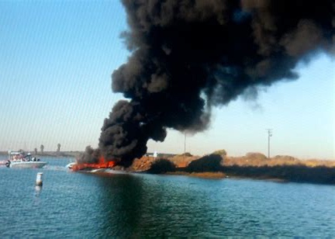
The Godson™
Episode 9
Fire in the Hole
On the flight home Scott decides to abandon
his vigilante trafficking activities and work on
The Bridge project to rehabilitate the homeless.
Leilani convinces him to spend more time in
Maui, to raise a family and enjoy their lives.
Chen and Jeannette greet them at the airport.
The Bridge facility is completed and a Grand
Opening celebration is scheduled for next week.
Antonia and Sal watch the newlyweds enter the Vallejo. Minutes later, the houseboat blows up.
The black smoke obscures their view, and they do not see Scott and Leilani jump safely into the bay.
Sal somberly declares that the deed is done,
but Antonia scoffs, “not until I find my money”.
Antonia blows up the Vallejo

Slide 20
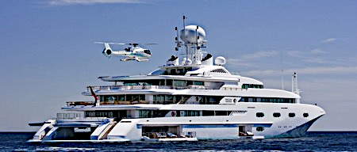
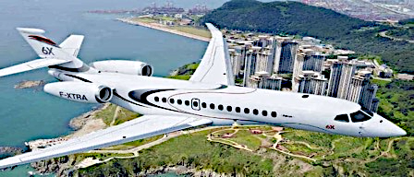
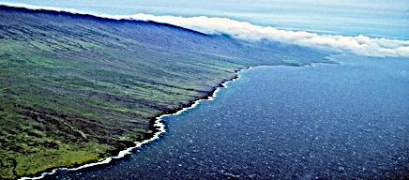
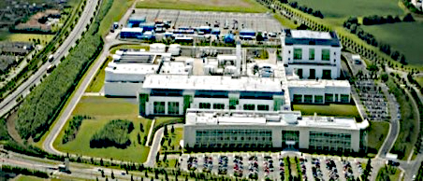
Seasons Two - Five
Seasons Two and Three
After surviving Antonia’s demolition of The Vallejo,
Scott buys a yacht as a mobile home and operations
center to attack Antonia’s Pacific trafficking network.
The Bridge wins international acclaim. Scott buys a
large ranch in Maui and creates a Hawaiian Cultural Center Foundation for Leilani and her brother Keola.
Seasons Four and Five
Antonia abandons trafficking and increases her drug
manufacturing operation and supplies the world’s
major drug cartels with addictive and lethal drugs.
Scott’s Rangers track Antonia to her drug factory in Ireland and nearly capture her before demolishing the entire drug manufacturing facility.

Slide 21


The Godfather Legacy
A Televisions Series
by
Garymerle Koeppel
Available on Request:
Pilot
Show Bible
Characters
Episodes 1-9
Seasons 1-5
Contact:
Garymerle Koeppel
gkoeppel@icloud.com
(831) 596 7711
Photos are portraits of characters envisioned by Screenwriter.
© GMK 2025

